Slide 1
Neo4j Cypher queries
Anju munoth

Slide 2
Cypher
Declarative graph query language that allows for expressive and efficient querying, updating and administering of the graph.
Suitable for both developers and operations professionals.
Simple, yet powerful; highly complicated database queries can be easily expressed, enabling you to focus on your domain, instead of getting lost in database access.
Inspired by a number of different approaches and builds on established practices for expressive querying.
Many of the keywords, such as WHERE and ORDER BY, are inspired by SQL.
Pattern matching borrows expression approaches from SPARQL.
Some of the list semantics are borrowed from languages such as Haskell and Python.
Cypher’s constructs, based on English prose and neat iconography, make queries easy, both to write and to read.

Slide 3
Neo4j DBMS
A Neo4j Database Management System is capable of containing and managing multiple graphs contained in databases.
Client applications will connect to the DBMS and open sessions against it.
A client session provides access to any graph in the DBMS.

Slide 4
Graph
Graph is a data model within a database.
Normally there is only one graph within each database, and many administrative commands that refer to a specific graph do so using the database name.
Cypher queries executed in a session may declare which graph they apply to, or use a default, given by the session.
Composite databases can contain multiple graphs, by means of aliases to other databases.
Queries submitted to composite databases may refer to multiple graphs within the same query.

Slide 5
Database
A database is a storage and retrieval mechanism for collecting data in a defined space on disk and in memory.
Most of the time Cypher queries are reading or updating queries, which are run against a graph.
There are also administrative commands that apply to a database, or to the entire DBMS.
Administrative commands cannot be run in a session connected to a normal user database, but instead need to be run within a session connected to the system database.
Administrative commands execute on the system database.
If an administrative command is submitted to a user database, it is rerouted to the system database.

Slide 6
system database and default database
All Neo4j servers contain a built-in database called system, which behaves differently than all other databases.
System database stores system data and you can not perform graph queries against it.
A fresh installation of Neo4j includes two databases:
system - the system database described above, containing meta-data on the DBMS and security configuration.
neo4j - the default database, named using the config option dbms.default_database=neo4j.

Slide 12
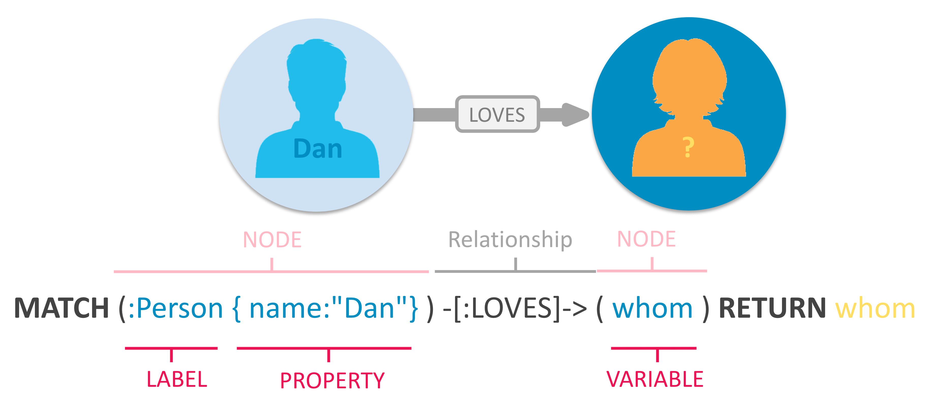

Slide 13
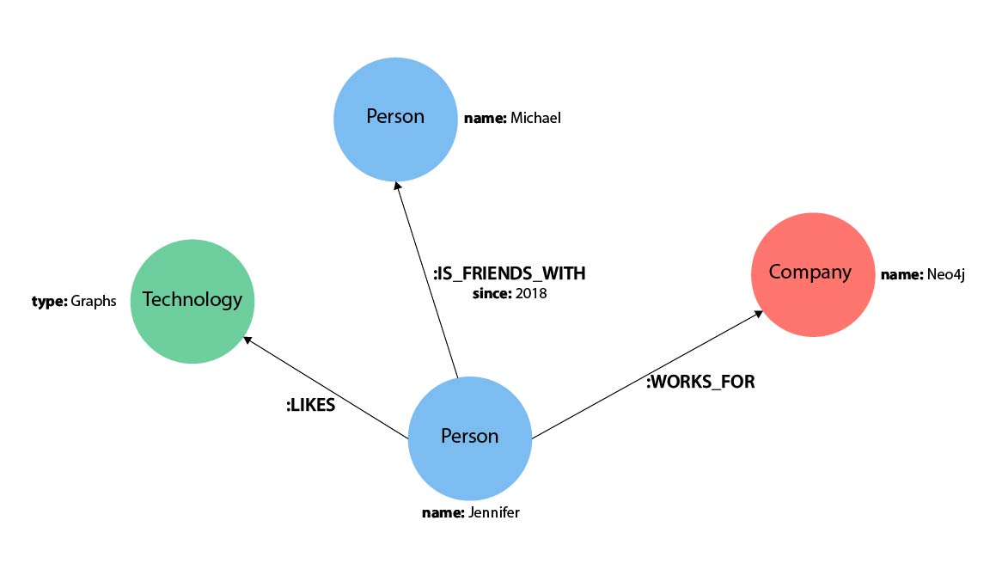

Slide 14
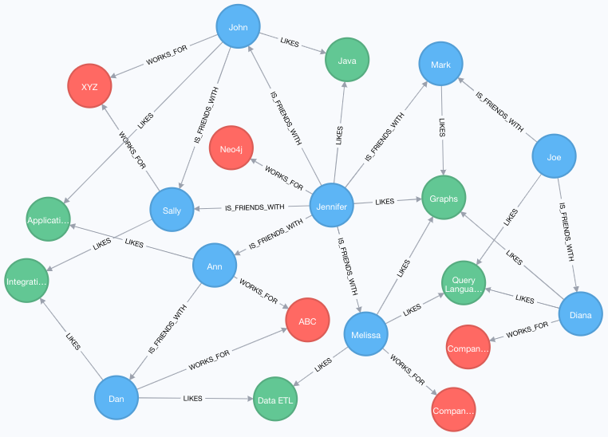

Slide 15
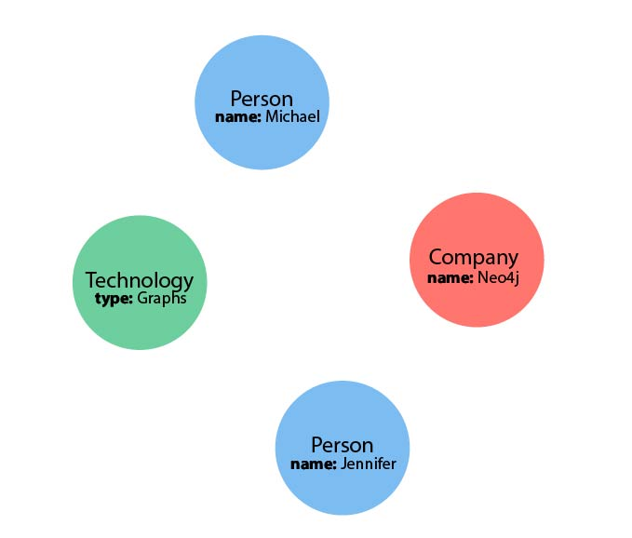
Representing Nodes in Cypher

Slide 16
Nodes
Nodes are the data entities in the graph
Can often identify nodes by finding the nouns or objects in the data model.
Jennifer, Michael, Graphs, and Neo4j are nodes.
To depict nodes in Cypher, surround the node with parentheses, e.g. (node)

Slide 17
Node Variables
To refer to the node, we can give it a variable like (p) for person or (t) for thing.
If the node is not relevant to your return results, you can specify an anonymous node using empty parentheses ().
This means that you will not be able to return this node later in the query.

Slide 18
Node Labels
Can also group similar nodes together by assigning a node label.
Labels are kind of like tags and allow you to specify certain types of entities to look for or create.
Person, Technology, and Company are the labels.
Can kind of think of this like telling SQL which table to look for the particular row.
Just like to tell SQL to query a person’s information from a Person or Employee or Customer table, you can also tell Cypher to only check those labels for that information.
Helps Cypher distinguish between entities and optimize execution for your queries.
Always better to use node labels in your queries, where possible.
If you do not specify a label for Cypher to filter out non-matching node categories, the query will check all of the nodes in the database!
Would be cumbersome if you had a very large graph.

Slide 19
Nodes in Cypher
() //anonymous node (no label or variable) can refer to any node in the database
(p:Person) //using variable p and label Person
(:Technology) //no variable, label Technology
(work:Company) //using variable work and label Company

Slide 20
Representing Relationships in Cypher
Relationships are represented in Cypher using an arrow --> or <-- between two nodes.
How nodes are connected (relationship type) and any properties pertaining to the relationship, can be placed in square brackets inside of the arrow.

Slide 21
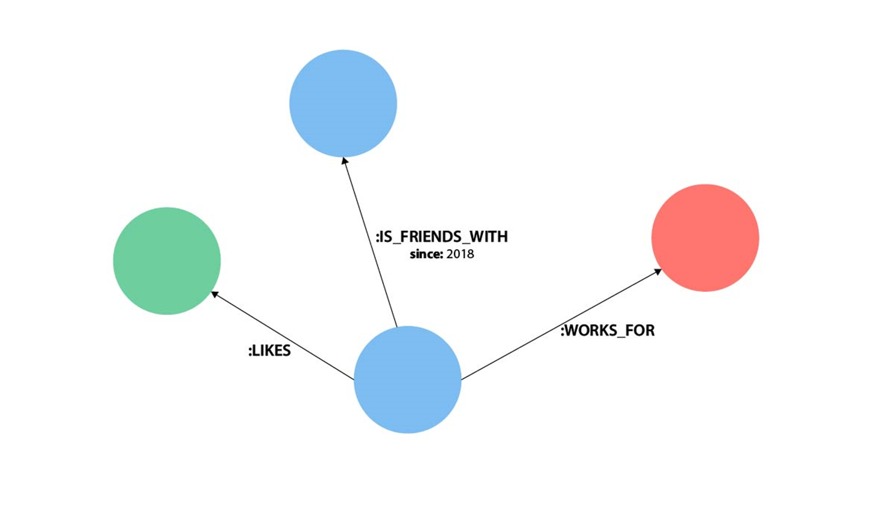
Lines with LIKES, IS_FRIENDS_WITH, and WORKS_FOR between nodes are relationships.

Slide 22
Relationships
Undirected relationships are represented with no arrow and just two dashes --.
Relationship can be traversed in either direction.
While a direction must be inserted to the database, it can be matched with an undirected relationship where Cypher ignores any particular direction and retrieves the relationship and connected nodes, no matter what the physical direction is.
Allows the queries to be flexible and not force the user to know the physical direction of the relationship stored in the database.
If data is stored with one relationship direction, and a query specifies the wrong direction, Cypher will not return any results.
In these cases where you may not be sure of direction, it is better to use an undirected relationship and retrieve some results.

Slide 23
Relationships
//data stored with this direction
CREATE (p:Person)-[:LIKES]->(t:Technology)
//query relationship backwards will not return results
MATCH (p:Person)<-[:LIKES]-(t:Technology)
//better to query with undirected relationship unless sure of direction
MATCH (p:Person)-[:LIKES]-(t:Technology)

Slide 24
Relationship Types
Relationship types categorize and add meaning to a relationship, similar to how labels group nodes.
Relationships show how nodes are connected and related to each other.
Can usually identify relationships in your data model by looking for actions or verbs.
Can specify any type of relationship you want between nodes, but we recommend good naming conventions using verbs and actions.
Poor relationship type names make it more difficult to both read and write Cypher

Slide 25
Relationship Variables
To refer to a relationship later in a query, can give it a variable like [r] or [rel].
Can also use longer, more expressive variable names like [likes] or [knows].
If you do not need to reference the relationship later, you can specify an anonymous relationship using two dashes --, -->, <--.
Could use either -[rel]-> or -[rel:LIKES]-> and call the rel variable later in your query to reference the relationship and its details.
If you forget the colon in front of a relationship type like this -[LIKES]->, it represents a variable (not a relationship type).
Since no relationship type declared, Cypher will search all types of relationships.

Slide 26
Node or Relationship Properties
Properties --Name-value pairs that provide additional details to nodes and relationships.
To represent --Use curly braces within the parentheses of a node or the brackets of a relationship.
Name and value of the property then go inside the curly braces.
Node property: (p:Person {name: 'Jennifer'})
Relationship property: -[rel:IS_FRIENDS_WITH {since: 2018}]->

Slide 27
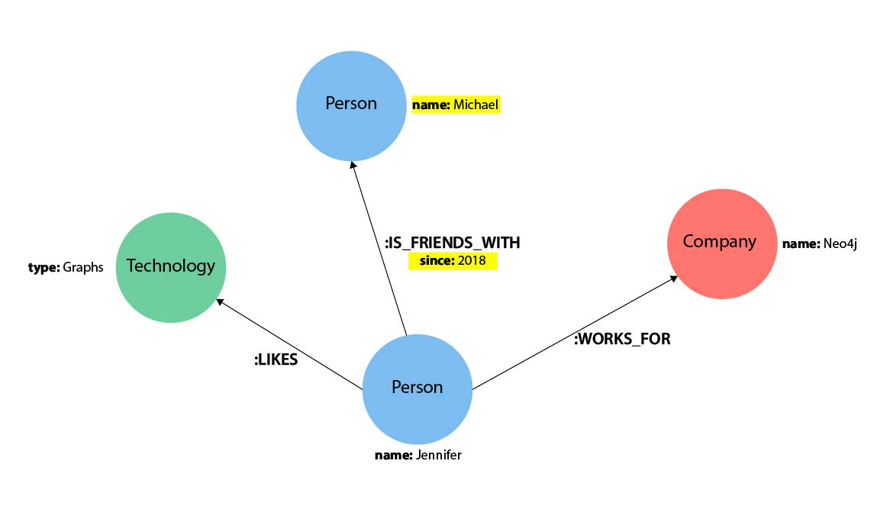

Slide 28
Property types
The following data types are included in the property types category: Integer, Float, String, Boolean, Point, Date, Time, LocalTime, DateTime, LocalDateTime, and Duration.
Property types can be returned from Cypher queries
Property types can be used as parameters
Property types can be stored as properties
Property types can be constructed with Cypher literals

Slide 29
Structural types
The following data types are included in the structural types category: Node, Relationship, and Path.
Structural types can be returned from Cypher queries
Structural types cannot be used as parameters
Structural types cannot be stored as properties
Structural types cannot be constructed with Cypher literals
The Node data type includes: Id, Label(s), and Map (of properties). Note that labels are not values, but a form of pattern syntax.
The Relationship data type includes: Id, Type, Map (of properties), Id of start node, and Id of end node.
The Path data type is an alternating sequence of nodes and relationships.

Slide 30
Composite types
The following data types are included in the composite types category: List and Map.
Composite types can be returned from Cypher queries
Composite types can be used as parameters
Composite types cannot be stored as properties
Composite types can be constructed with Cypher literals
The List data type is a heterogeneous, ordered collection of values, each of which can have any property, structural or composite type.
Homogeneous lists of simple types can be stored as properties.
The Map data type is a heterogeneous, unordered collection of (Key, Value) pairs, where Key is a string and Value can have any property, structural, or composite type.

Slide 31
Naming Recommendations
Node labels | Camel-case, beginning with an upper-case character | :VehicleOwner rather than :vehicle_owner etc.
Relationship types | Upper-case, using underscore to separate words | :OWNS_VEHICLE rather than :ownsVehicle etc.

Slide 32
Patterns in Cypher
Nodes and relationships make up the building blocks for graph patterns.
These building blocks can come together to express simple or complex patterns.
Patterns are the most powerful capability of graphs.
In Cypher, they can be written as a continuous path or separated into smaller patterns and tied together with commas.
To show a pattern in Cypher, we need to combine the node and relationship syntax
(p:Person {name: "Jennifer"})-[rel:LIKES]->(g:Technology {type: "Graphs"})

Slide 33
Clauses used to read from the graph
MATCH: The graph pattern to match. This is the most common way to get data from the graph.
WHERE: Not a clause in its own right, but rather part of MATCH, OPTIONAL MATCH and WITH.
Adds constraints to a pattern, or filters the intermediate result passing through WITH.
RETURN: What to return.

Slide 34
Update the graph
CREATE (and DELETE): Create (and delete) nodes and relationships.
SET (and REMOVE): Set values to properties and add labels on nodes using SET and use REMOVE to remove them.
MERGE: Match existing or create new nodes and patterns. This is especially useful together with property uniqueness constraints.

Slide 35
Operators
Aggregation operators | DISTINCT
Property operators | . for static property access, [] for dynamic property access, = for replacing all properties, += for mutating specific properties
Mathematical operators | +, -, *, /, %, ^
Comparison operators | =, <>, <, >, <=, >=, IS NULL, IS NOT NULL
String-specific comparison operators | STARTS WITH, ENDS WITH, CONTAINS, =~ (regex matching)
Boolean operators | AND, OR, XOR, NOT

Slide 36
Operators
String operators | + (string concatenation)
Temporal operators | + and - for operations between durations and temporal instants/durations, * and / for operations between durations and numbers
Map operators | . for static value access by key, [] for dynamic value access by key
List operators | + (list concatenation), IN to check existence of an element in a list, [] for accessing element(s) dynamically

Slide 37
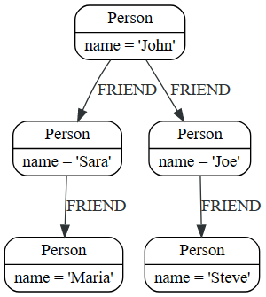

Slide 38
Create nodes and relationship
CREATE (john:Person {name: 'John'})
CREATE (joe:Person {name: 'Joe'})
CREATE (steve:Person {name: 'Steve'})
CREATE (sara:Person {name: 'Sara'})
CREATE (maria:Person {name: 'Maria'})
CREATE (john)-[:FRIEND]->(joe)-[:FRIEND]->(steve)
CREATE (john)-[:FRIEND]->(sara)-[:FRIEND]->(maria)

Slide 39
MATCH (john:Person {name: 'John'}) MATCH (john)-[:FRIEND]->(friend) RETURN friend.name AS friendName

Slide 40
Read with intermediate steps
Clause | Table of intermediate results after the clause
MATCH (john:Person {name: 'John'}) | john ({name: 'John'})
MATCH (john)-[:FRIEND]->(friend) | john friend ({name: 'John’}) ({name: 'Sara'}) ({name: 'John’}) ({name: 'Joe'})
RETURN friend.name AS friendName | friendName 'Sara' 'Joe'

Slide 41
Read-write queries
MATCH (j:Person) WHERE j.name STARTS WITH "J" CREATE (j)-[:FRIEND]->(jj:Person {name: "Jay-jay"})

Slide 42
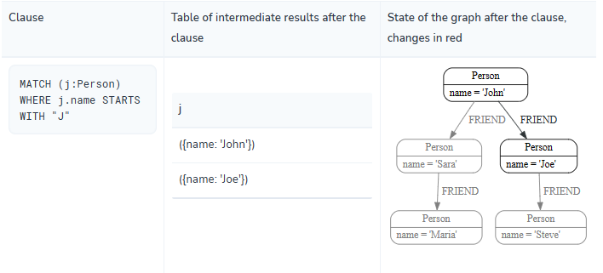
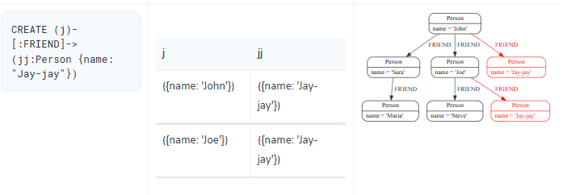

Slide 43
MATCH (john {name: 'John'})-[:FRIEND]->()-[:FRIEND]->(fof) RETURN john.name, fof.name
Query which finds a user called 'John' and 'John’s' friends (though not his direct friends) before returning both 'John' and any friends-of-friends that are found.

Slide 44
MATCH (user)-[:FRIEND]->(follower) WHERE user.name IN ['Joe', 'John', 'Sara', 'Maria', 'Steve'] AND follower.name =~ 'S.*' RETURN user.name, follower.name
Take a list of user names and find all nodes with names from this list, match their friends and return only those followed users who have a 'name' property starting with 'S'.

Slide 45
MATCH
The MATCH keyword in Cypher is what searches for an existing node, relationship, label, property, or pattern in the database.
MATCH works pretty much like SELECT in SQL.
Can find all node labels in the database, search for a particular node, find all the nodes with a particular relationship, look for patterns of nodes and relationships, and much more using MATCH.

Slide 46
RETURN
Specifies what values or results you might want to return from a Cypher query.
Can tell Cypher to return nodes, relationships, node and relationship properties, or patterns in your query results.
RETURN is not required when doing write procedures, but is needed for reads.
In order to bring back nodes, relationships, properties, or patterns, you need to have variables specified in your MATCH clause for the data you want to return.

Slide 47
Example
Find the labeled Person nodes in the graph.
Note the use a variable like p for the Person node to retrieve the node in the RETURN clause.
MATCH (p:Person) RETURN p LIMIT 1

Slide 48
Example
Find Person nodes in the graph that have a name of 'Tom Hanks’
MATCH (tom:Person {name: 'Tom Hanks'}) RETURN tom

Slide 49
Find which `Movie`s Tom Hanks has directed
Need to find Tom Hanks' Person node, and need to find the Movie nodes he is connected to.
To do that, need to follow the DIRECTED relationship from Tom Hanks' Person node to the Movie node.
Have also specified a label of Movie so that the query will only look at nodes with that label.
Since we only care about returning the movie in this query, we need to give that node a variable (movie) but do not need to give variables for the Person node or DIRECTED relationship.
MATCH (:Person {name: 'Tom Hanks'})-[:DIRECTED]->(movie:Movie) RETURN movie

Slide 50
Find which Movie Tom Hanks has directed, but this time, return only the title of the movie
Need to find Tom’s movies, but now we only care about their titles.
Will need to access the node’s title property using the syntax variable.property to return the name value.
MATCH (:Person {name: 'Tom Hanks'})-[:DIRECTED]->(movie:Movie) RETURN movie.title

Slide 51
Aliasing Return Values
Some properties have poor names due to property length, multi-word descriptions, developer jargon, and other shortcuts.
These naming conventions can be difficult to read, especially if they end up on reports and other user-facing interfaces.
// poorly named property
MATCH (tom:Person {name:'Tom Hanks'})-[rel:DIRECTED]-(movie:Movie) RETURN tom.name, tom.born, movie.title, movie.released
/cleaner printed results with aliasing
MATCH (tom:Person {name:'Tom Hanks'})-[rel:DIRECTED]-(movie:Movie) RETURN tom.name AS name, tom.born AS `Year Born`, movie.title AS title, movie.released AS `Year Released`

Slide 52
Find the title and year of release for every :Movie that Tom Hanks has :DIRECTED
MATCH (p:Person {name: "Tom Hanks"})-[:DIRECTED]->(m:Movie) RETURN m.title, m.released

Slide 53
Updating Data with Cypher
Update Jennifer’s node to add her birthday
MATCH (p:Person {name: 'Jennifer'}) SET p.birthdate = date('1980-01-01') RETURN p
Could also update Jennifer’s WORKS_FOR relationship with her company to include the year that she started working there
MATCH (:Person {name: 'Jennifer'})-[rel:WORKS_FOR]-(:Company {name: 'Neo4j'}) SET rel.startYear = date({year: 2018}) RETURN rel

Slide 54
Deleting Data with Cypher
Because Neo4j is ACID-compliant, cannot delete a node if it still has relationships
Might end up with a relationship pointing to nothing and an incomplete graph.

Slide 55
Delete a Relationship
To delete a relationship, need to find the start and end nodes for the relationship you want to delete and then use the DELETE keyword.
Delete the IS_FRIENDS_WITH relationship between Jennifer and Mark
MATCH (j:Person {name: 'Jennifer'})-[r:IS_FRIENDS_WITH]->(m:Person {name: 'Mark'}) DELETE r

Slide 56
Delete a Node
To delete a node that does not have any relationships, need to find the node you want to delete and then use the DELETE keyword
Can delete Mark’s node
MATCH (m:Person {name: 'Mark'}) DELETE m

Slide 57
Delete a Node and Relationship
Can actually run a single statement to delete the node and relationship at the same time.
Neo4j is ACID-compliant so it doesn’t allow us to delete a node if it still has relationships.
Using the DETACH DELETE syntax tells Cypher to delete any relationships the node has, as well as remove the node itself.
DETACH DELETE line removes any existing relationships Mark has before also deleting his node.
MATCH (m:Person {name: 'Mark'}) DETACH DELETE m

Slide 58
Delete Properties
Can also remove properties,
Use REMOVE on the property --Remove the property from the node entirely and no longer store it.
OR
Use the SET keyword to set the property value to null.
Unlike other database models, Neo4j does not store null values.
Instead, it only stores properties and values that are meaningful to your data.
This means that you can have different types and amounts of properties on various nodes and relationships in your graph.

Slide 59
Delete Properties
//delete property using REMOVE keyword
MATCH (n:Person {name: 'Jennifer'}) REMOVE n.birthdate
//delete property with SET to null value
MATCH (n:Person {name: 'Jennifer'}) SET n.birthdate = null

Slide 60
MERGE
MERGE does a "select-or-insert" operation that first checks if the data exists in the database.
If it exists, then Cypher returns it as is or makes any updates you specify on the existing node or relationship.
If the data does not exist, then Cypher will create it with the information you specify.

Slide 61
Using Merge on a Node
Use MERGE to ensure that Cypher checks the database for an existing node for Mark.
If no existing match --will create the node new with the name property set to 'Mark’.
If existing node --will return the matched node without any changes.
MERGE (mark:Person {name: 'Mark'}) RETURN mark

Slide 62
Using Merge on a Relationship
Used to find or create a relationship.
MATCH (j:Person {name: 'Jennifer'}) MATCH (m:Person {name: 'Mark'}) MERGE (j)-[r:IS_FRIENDS_WITH]->(m) RETURN j, r, m
Used MATCH here to find both Mark’s node and Jennifer’s node before we used MERGE to find or create the relationship.
MERGE looks for an entire pattern that you specify to see whether to return an existing one or create it new.
If the entire pattern (nodes, relationships, and any specified properties) does not exist, Cypher will create it.

Slide 63
Merge with duplicates
Below Cypher statement that will cause duplicates is below.
Because this pattern (Jennifer IS_FRIENDS_WITH Mark) does not exist in the database, Cypher creates the entire pattern new - both nodes, as well as the relationship between them.
//this statement will create duplicate nodes for Mark and Jennifer
MERGE (j:Person {name: 'Jennifer'})-[r:IS_FRIENDS_WITH]->(m:Person {name: 'Mark'}) RETURN j, r, m

Slide 64
Handling MERGE Criteria
To use MERGE and to ensure you do not create duplicates, but you want to initialize certain properties if the pattern is created and update other properties if it is only matched.
In this case, you can use ON CREATE or ON MATCH with the SET keyword to handle these situations.
MERGE (m:Person {name: 'Mark'})-[r:IS_FRIENDS_WITH]-(j:Person {name:'Jennifer'}) ON CREATE SET r.since = date('2018-03-01') ON MATCH SET r.updated = date() RETURN m, r, j

Slide 65
WHERE clause
//query using equality check in the MATCH clause
MATCH (j:Person {name: 'Jennifer'}) RETURN j;
//query using equality check in the WHERE clause
MATCH (j:Person) WHERE j.name = 'Jennifer' RETURN j;
Both queries will do the same thing and return the same results.
Both queries execute with the same performance, so which way you write them is entirely up to your preference and comfort.

Slide 66
Negating Properties
Can run in Cypher with the standard boolean operators AND, OR, XOR, and NOT
//query using inequality check in the WHERE clause
MATCH (j:Person) WHERE NOT j.name = 'Jennifer' RETURN j

Slide 67
Querying Ranges of Values
MATCH (p:Person) WHERE 3 <= p.yearsExp <= 7 RETURN p
MATCH (p:Person) WHERE p.yearsExp IN [1, 5, 6] RETURN p.name, p.yearsExp

Slide 68
Testing if a Property Exists
//Query1: find all users who have a birthdate property
MATCH (p:Person) WHERE exists(p.birthdate) RETURN p.name;
//Query2: find all WORKS_FOR relationships that have a startYear property
MATCH (p:Person)-[rel:WORKS_FOR]->(c:Company) WHERE exists(rel.startYear) RETURN p, rel, c;

Slide 69
Checking Strings - Partial Values, Fuzzy Searches, and More
//check if a property starts with 'M’
MATCH (p:Person) WHERE p.name STARTS WITH 'M' RETURN p.name;
//check if a property contains 'a’
MATCH (p:Person) WHERE p.name CONTAINS 'a' RETURN p.name;
//check if a property ends with 'n’
MATCH (p:Person) WHERE p.name ENDS WITH 'n' RETURN p.name;
//check for a regular expression pattern
MATCH (p:Person) WHERE p.name =~ 'Jo.*' RETURN p.name

Slide 70
Filtering on Patterns
//Query1: find which people are friends of someone who works for Neo4j
MATCH (p:Person)-[r:IS_FRIENDS_WITH]->(friend:Person) WHERE exists((p)-[:WORKS_FOR]->(:Company {name: 'Neo4j'})) RETURN p, r, friend;
//Query2: find Jennifer's friends who do not work for a company
MATCH (p:Person)-[r:IS_FRIENDS_WITH]->(friend:Person) WHERE p.name = 'Jennifer' AND NOT exists((friend)-[:WORKS_FOR]->(:Company)) RETURN friend.name;

Slide 71
Optional Patterns
//find all people whose name starts with J and who may work for a company.
MATCH (p:Person) WHERE p.name STARTS WITH 'J' OPTIONAL MATCH (p)-[:WORKS_FOR]-(other:Company) RETURN p.name, other.name;

Slide 72
Example
//Query1: find who likes graphs besides Jennifer
MATCH (j:Person {name: 'Jennifer'})-[r:LIKES]-(graph:Technology {type: 'Graphs'})-[r2:LIKES]-(p:Person) RETURN p.name;
//Query2: find who likes graphs besides Jennifer that she is also friends with
MATCH (j:Person {name: 'Jennifer'})-[:LIKES]->(:Technology {type: 'Graphs'})<-[:LIKES]-(p:Person), (j)-[:IS_FRIENDS_WITH]-(p) RETURN p.name;

Slide 73
Aggregating by Count
count(n) --Count the number of occurences of n and does not include null values.
Can specify nodes, relationships, or properties within the parentheses for Cypher to count.
count(*) -- Counts the number of result rows returned (including those with null values).

Slide 74
Example of count()
//Query1: see the list of Twitter handle values for Person nodes
MATCH (p:Person) RETURN p.twitter;
//Query2: count of the non-null `twitter` property of the Person nodes
MATCH (p:Person) RETURN count(p.twitter);
//Query3: count on the Person nodes
MATCH (p:Person) RETURN count(*);

Slide 75
Aggregating Values
collect() function in Cypher --Aggregate values into a list.
Can use this to group a set of values based on a particular starting node, relationship, property.
MATCH (p:Person)-[:IS_FRIENDS_WITH]->(friend:Person) RETURN p.name, collect(friend.name) AS friend
// find and list the technologies people like
MATCH (a:Person)-[r:LIKES]-(t:Technology) WITH a.name AS name, collect(t.type) AS technologies RETURN name, technologies;

Slide 76
Counting Values in a List
find the number of items in that list or calculate the size of an expression using the size() function.
//find number of items in collected list
MATCH (p:Person)-[:IS_FRIENDS_WITH]->(friend:Person) RETURN p.name, size(collect(friend.name)) AS numberOfFriends;

Slide 77
Examples
// find number of friends who have other friends
MATCH (p:Person)-[:IS_FRIENDS_WITH]->(friend:Person) WHERE size((friend)-[:IS_FRIENDS_WITH]-(:Person)) > 1 RETURN p.name, collect(friend.name) AS friends, size((friend)-[:IS_FRIENDS_WITH]-(:Person)) AS numberOfFoFs;
//find number of friends who have other friends - cleaner Query
MATCH (p:Person)-[:IS_FRIENDS_WITH]->(friend:Person) WITH p, collect(friend.name) AS friendsList, size((friend)-[:IS_FRIENDS_WITH]-(:Person)) AS numberOfFoFs WHERE numberOfFoFs > 1 RETURN p.name, friendsList, numberOfFoFs;

Slide 78
With clause
//find people with 2-6 years of experience
WITH 2 AS experienceMin, 6 AS experienceMax MATCH (p:Person) WHERE experienceMin <= p.yrsExperience <= experienceMax RETURN p

Slide 79
Looping through List Values
if you have a list that you want to inspect or separate the values, Cypher offers the UNWIND clause.
Does the opposite of collect() and separates a list into individual values on separate rows.
Using UNWIND is frequently used for looping through JSON and XML objects when importing data, as well as everyday arrays and other types of lists.

Slide 80
Looping through List Values
//Query: for a list of techRequirements, look for people who have each skill
WITH ['Graphs','Query Languages'] AS techRequirements UNWIND techRequirements AS technology MATCH (p:Person)-[r:LIKES]-(t:Technology {type: technology}) RETURN t.type, collect(p.name) AS potentialCandidates;
//Query: for numbers in a list, find candidates who have that many years of experience
WITH [4, 5, 6, 7] AS experienceRange UNWIND experienceRange AS number MATCH (p:Person) WHERE p.yearsExp = number RETURN p.name, p.yearsExp;

Slide 81
Ordering Results
//Query: for a list of techRequirements, look for people who have each skill - ordered by texhnology and name
WITH ['Graphs','Query Languages'] AS techRequirements UNWIND techRequirements AS technology MATCH (p:Person)-[r:LIKES]-(t:Technology {type: technology}) WITH t.type AS technology, p.name AS personName ORDER BY technology, personName RETURN technology, collect(personName) AS potentialCandidates;

Slide 82
//Query: for numbers in a list, find candidates who have that many years of experience - ordered by years of experience
WITH [4, 5, 6, 7] AS experienceRange UNWIND experienceRange AS number MATCH (p:Person) WHERE p.yearsExp = number RETURN p.name, p.yearsExp ORDER BY p.yearsExp DESC;

Slide 83
//only sorted by person's name in alphabetical order
WITH ['Graphs','Query Languages'] AS techRequirements UNWIND techRequirements AS technology MATCH (p:Person)-[r:LIKES]-(t:Technology {type: technology}) WITH t.type AS technology, p.name AS personName ORDER BY personName RETURN technology, personName;
//only sorted by technology (person names are out of order)
WITH ['Graphs','Query Languages'] AS techRequirements UNWIND techRequirements AS technology MATCH (p:Person)-[r:LIKES]-(t:Technology {type: technology}) WITH t.type AS technology, p.name AS personName ORDER BY technology RETURN technology, personName;
//sorted by technology, then by person's name
WITH ['Graphs','Query Languages'] AS techRequirements UNWIND techRequirements AS technology MATCH (p:Person)-[r:LIKES]-(t:Technology {type: technology}) WITH t.type AS technology, p.name AS personName ORDER BY technology, personName RETURN technology, personName;

Slide 84
Returning Unique Results
//Query: find people who have a twitter or like graphs or query languages
MATCH (user:Person) WHERE user.twitter IS NOT null WITH user MATCH (user)-[:LIKES]-(t:Technology) WHERE t.type IN ['Graphs','Query Languages'] RETURN DISTINCT user.name

Slide 85
Using the DISTINCT operator
Retrieve the unique eye colors from Person nodes.
CREATE (a:Person {name: 'Anne', eyeColor: 'blue'}), (b:Person {name: 'Bill', eyeColor: 'brown'}), (c:Person {name: 'Carol', eyeColor: 'blue'}) WITH [a, b, c] AS ps UNWIND ps AS p RETURN DISTINCT p.eyeColor

Slide 86
Limiting Number of Results
//Query: find the top 3 people who have the most friends
MATCH (p:Person)-[r:IS_FRIENDS_WITH]-(other:Person) RETURN p.name, count(other.name) AS numberOfFriends ORDER BY numberOfFriends DESC LIMIT 3

Slide 87
Queries with UNION
UNION queries are slightly different because the results of two or more queries are put together, but each query starts with an empty table of intermediate results.
In a query with a UNION clause, any clause before the UNION cannot observe writes made by a clause after the UNION.
Any clause after UNION can observe all writes made by a clause before the UNION.
This means that the rule that a clause can never observe writes made by a later clause still applies in queries using UNION.

Slide 88
Queries with UNION
CREATE (jj:Person {name: "Jay-jay"}) RETURN count(*) AS count UNION MATCH (j:Person) WHERE j.name STARTS WITH "J" RETURN count(*) AS count

Slide 89
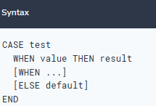
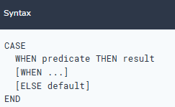
CASE expressions

Slide 90
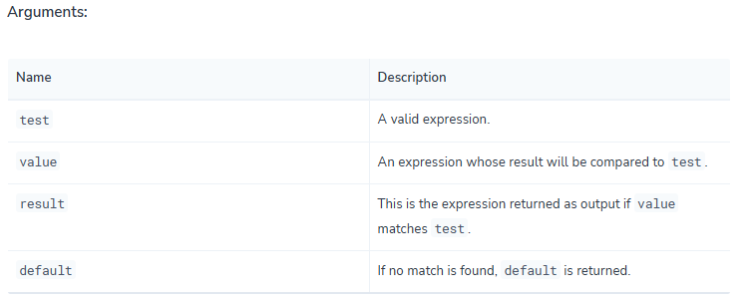

Slide 91
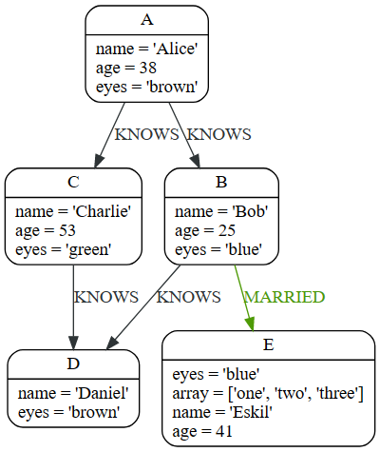
CASE expressions

Slide 92
MATCH (n) RETURN CASE n.eyes WHEN 'blue' THEN 1 WHEN 'brown' THEN 2 ELSE 3 END AS result
MATCH (n) RETURN CASE WHEN n.eyes = 'blue' THEN 1 WHEN n.age < 40 THEN 2 ELSE 3 END AS result
MATCH (n) RETURN n.name, CASE n.age WHEN n.age IS NULL THEN -1 ELSE n.age - 10 END AS age_10_years_ago
MATCH (n) RETURN n.name, CASE WHEN n.age IS NULL THEN -1 ELSE n.age - 10 END AS age_10_years_ago
MATCH (n) WITH n, CASE n.eyes WHEN 'blue' THEN 1 WHEN 'brown' THEN 2 ELSE 3 END AS colourCode SET n.colourCode = colourCode

Slide 93
Filtering on a dynamically-computed property key using the [] operator
CREATE (a:Restaurant {name: 'Hungry Jo', rating_hygiene: 10, rating_food: 7}), (b:Restaurant {name: 'Buttercup Tea Rooms', rating_hygiene: 5, rating_food: 6}), (c1:Category {name: 'hygiene'}), (c2:Category {name: 'food'}) WITH a, b, c1, c2 MATCH (restaurant:Restaurant), (category:Category) WHERE restaurant["rating_" + category.name] > 6 RETURN DISTINCT restaurant.name

Slide 94
Replacing all properties of a node or relationship using the = operator
CREATE (a:Person {name: 'Sofia', age: 20}) WITH a MATCH (p:Person {name: 'Sofia'}) SET p = {name: 'Ellen', livesIn: 'London'} RETURN p.name, p.age, p.livesIn
All the existing properties on the node are replaced by those provided in the map; i.e. the name property is updated from Sofia to Ellen, the age property is deleted, and the livesIn property is added.

Slide 95
Mutating specific properties of a node or relationship using the += operator
CREATE (a:Person {name: 'Sofia', age: 20}) WITH a MATCH (p:Person {name: 'Sofia'}) SET p += {name: 'Ellen', livesIn: 'London'} RETURN p.name, p.age, p.livesIn
The properties on the node are updated as follows by those provided in the map: the name property is updated from Sofia to Ellen, the age property is left untouched, and the livesIn property is added

Slide 96
Variable-length pattern matching
Rather than describing a long path using a sequence of many node and relationship descriptions in a pattern, many relationships (and the intermediate nodes) can be described by specifying a length in the relationship description of a pattern.
For example:
(a)-[*2]->(b)
This describes a graph of three nodes and two relationships, all in one path (a path of length 2). This is equivalent to:
(a)-->()-->(b)

Slide 97
Variable Length Relationship
A range of lengths can also be specified: such relationship patterns are called 'variable length relationships'. For example:
(a)-[*3..5]->(b)
This is a minimum length of 3, and a maximum of 5.
It describes a graph of either 4 nodes and 3 relationships, 5 nodes and 4 relationships or 6 nodes and 5 relationships, all connected together in a single path.
Either bound can be omitted. For example, to describe paths of length 3 or more, use:
(a)-[*3..]->(b)
To describe paths of length 5 or less, use:
(a)-[*..5]->(b)

Slide 98
Variable Length Relationship
Omitting both bounds is equivalent to specifying a minimum of 1, allowing paths of any positive length to be described:
(a)-[*]->(b)

Slide 99
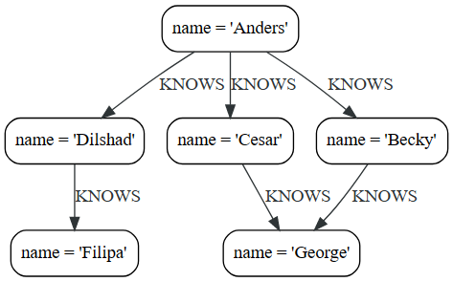

Slide 100
Variable Length Relationship
finds data in the graph with a shape that fits the pattern: specifically a node (with the name property 'Filipa') and then the KNOWS related nodes, one or two hops away.
This is a typical example of finding first and second degree friends.
MATCH (me)-[:KNOWS*1..2]-(remote_friend) WHERE me.name = 'Filipa' RETURN remote_friend.name
remote_friend.name
"Dilshad"
"Anders"

Slide 101
List comprehension
List comprehension is a syntactic construct available in Cypher for creating a list based on existing lists.
Follows the form of the mathematical set-builder notation (set comprehension) instead of the use of map and filter functions.
RETURN [x IN range(0,10) WHERE x % 2 = 0 | x^3 ] AS result
result
[0.0,8.0,64.0,216.0,512.0,1000.0]

Slide 102
List comprehension
RETURN [x IN range(0,10) WHERE x % 2 = 0 ] AS result
result
[0,2,4,6,8,10]
RETURN [x IN range(0,10) | x^3 ] AS result
result
[0.0,1.0,8.0,27.0,64.0,125.0,216.0,343.0,512.0,729.0,1000.0]

Slide 103
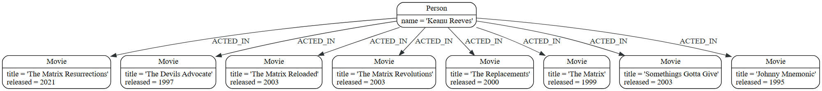
Pattern Comprehension

Slide 104
Pattern Comprehension
list that contains the year when the movies was released.
The pattern matching in the pattern comprehension looks for Matrix in the movie title and that the node a (Person node with the name Keanu Reeves) has a relationship with the movie.
MATCH (a:Person {name: 'Keanu Reeves'}) RETURN [(a)-->(b:Movie) WHERE b.title CONTAINS 'Matrix' | b.released] AS years
years
[2021,2003,2003,1999]

Slide 105
Pattern Comprehension
Returns a sorted list that contains years.
The pattern matching in the pattern comprehension looks for movie nodes that has a relationship with the node a (Person node with the name Keanu Reeves).
MATCH (a:Person {name: 'Keanu Reeves'}) WITH [(a)-->(b:Movie) | b.released] AS years UNWIND years AS year WITH year ORDER BY year RETURN COLLECT(year) AS sorted_years
sorted_years
[1995,1997,1999,2000,2003,2003,2003,2021]

Slide 106
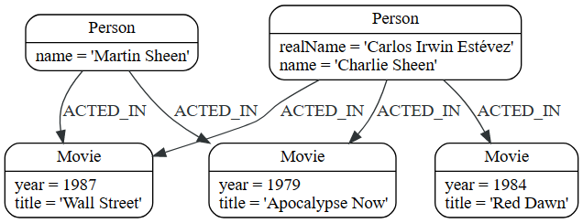
Map projections

Slide 107
Map projections
allows for easily constructing map projections from nodes, relationships and other map values.
A map projection begins with the variable bound to the graph entity to be projected from, and contains a body of comma-separated map elements, enclosed by { and }.
map_variable {map_element, [, ...n]}
If the map_variable points to a null value, the whole map projection will evaluate to null.
The key names in a map must be of type String.

Slide 108
Map projections
A map element projects one or more key-value pairs to the map projection.
There exist four different types of map projection elements:
Property selector - Projects the property name as the key, and the value from the map_variable as the value for the projection.
Literal entry - This is a key-value pair, with the value being arbitrary expression key: <expression>.
Variable selector - Projects a variable, with the variable name as the key, and the value the variable is pointing to as the value of the projection. Its syntax is just the variable.
All-properties selector - projects all key-value pairs from the map_variable value.

Slide 109
Map projections
Find 'Charlie Sheen' and return data about him and the movies he has acted in.
This example shows an example of map projection with a literal entry, which in turn also uses map projection inside the aggregating collect().
MATCH (actor:Person {name: 'Charlie Sheen'})-[:ACTED_IN]->(movie:Movie) WITH actor, collect(movie{.title, .year}) AS movies RETURN actor{.name, .realName, movies: movies}
actor
{'movies': [{'year': 1979, 'title': 'Apocalypse Now'}, {'year': 1984, 'title': 'Red Dawn'}, {'year': 1987, 'title': 'Wall Street'}], 'realName': 'Carlos Irwin Estévez', 'name': 'Charlie Sheen'}

Slide 110
Map projections
Find all persons that have acted in movies, and show number for each. This example introduces an variable with the count, and uses a variable selector to project the value.
MATCH (actor:Person)-[:ACTED_IN]->(movie:Movie) WITH actor, count(movie) AS nbrOfMovies RETURN actor{.name, nbrOfMovies}
actor
{nbrOfMovies -> 2, name -> "Martin Sheen"}
{nbrOfMovies -> 3, name -> "Charlie Sheen"}

Slide 111
Map projections
Again, focusing on 'Charlie Sheen', this time returning all properties from the node.
Here we use an all-properties selector to project all the node properties, and additionally, explicitly project the property age.
Since this property does not exist on the node, a null value is projected instead.
MATCH (actor:Person {name: 'Charlie Sheen'}) RETURN actor{.*, .age}
actor
{'realName': 'Carlos Irwin Estévez', 'name': 'Charlie Sheen', 'age': None}

Slide 112
Map projections

